Slide 1

Mount Sinai Adolescent Health Center

Slide 2
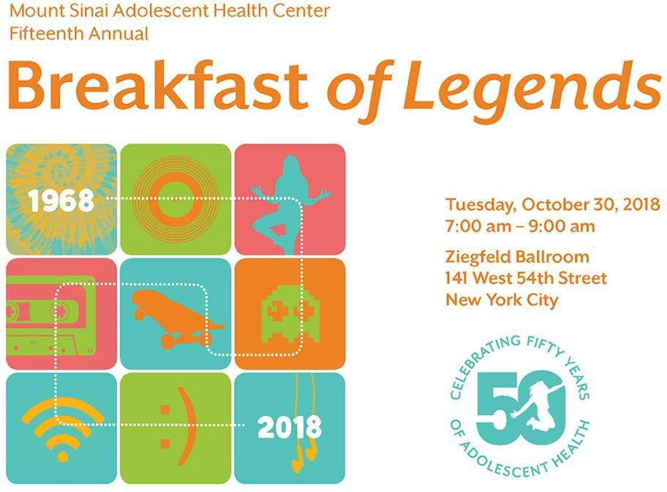

Slide 3



Slide 4
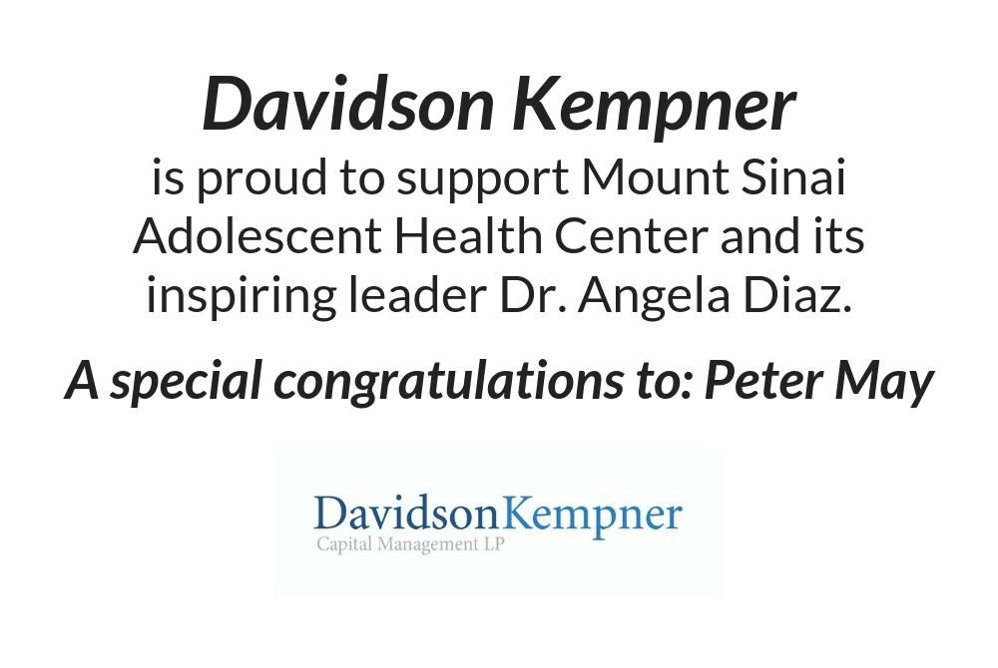

Slide 5

CHEER THE
MOUNT SINAI ADOLESCENT HEALTH CENTER
FOR THEIR INCREDIBLE, AWESOME 50TH ANNIVERSARY
SERVING NEW YORK CITY'S YOUTH WITH KINDNESS AND EXPERTISE BARBARA AND TOM ISRAEL

Slide 6
Congratulations to Angela
and her amazing staff
on their 50th birthday!
Barbara and Tom Israel Dr. Emily Pluhar

Slide 7

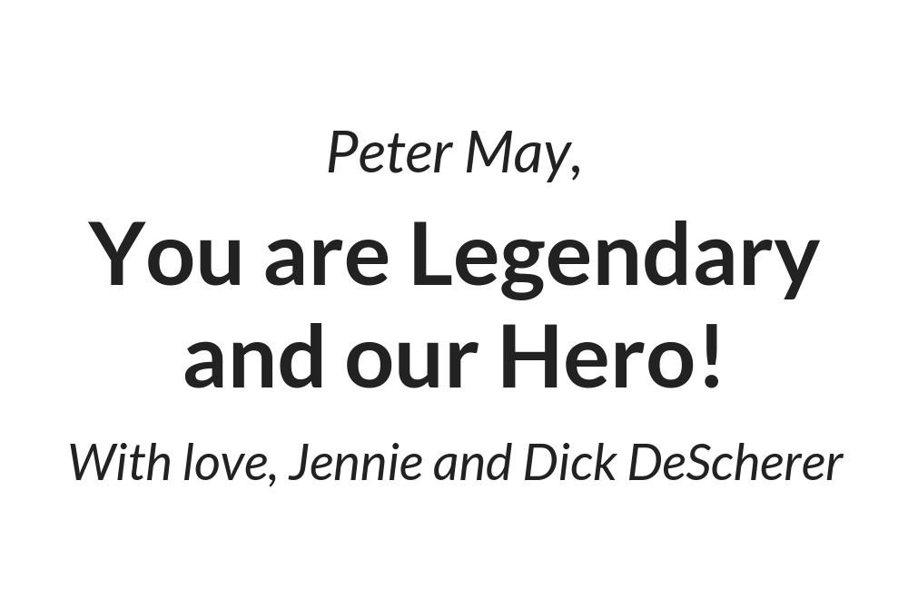

Slide 8
We expresses our gratitude for and admiration of the work
Dr. Angela Diaz
and the entire staff at the
Mount Sinai Adolescent Health Center
do for the youth in our community!
The Cullman/Sicher Family

Slide 9
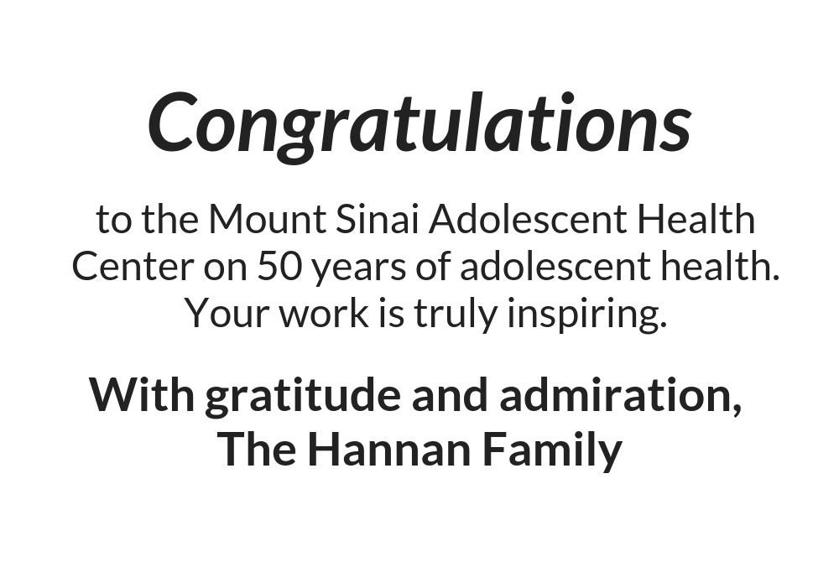

Slide 10

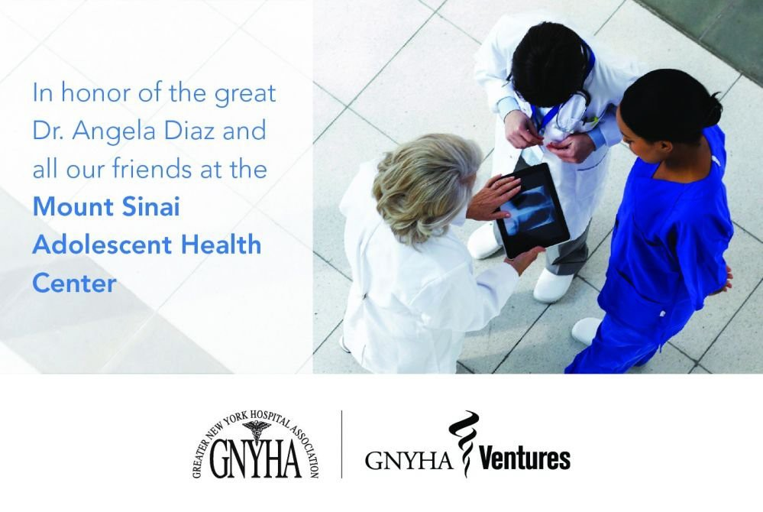

Slide 11
Congratulations to the
Mount Sinai Adolescent Health Center
on another fabulous year
and to the sensational leadership of
Dr. Angela Diaz
Warmly,
The Sacks Family

Slide 12



Slide 13
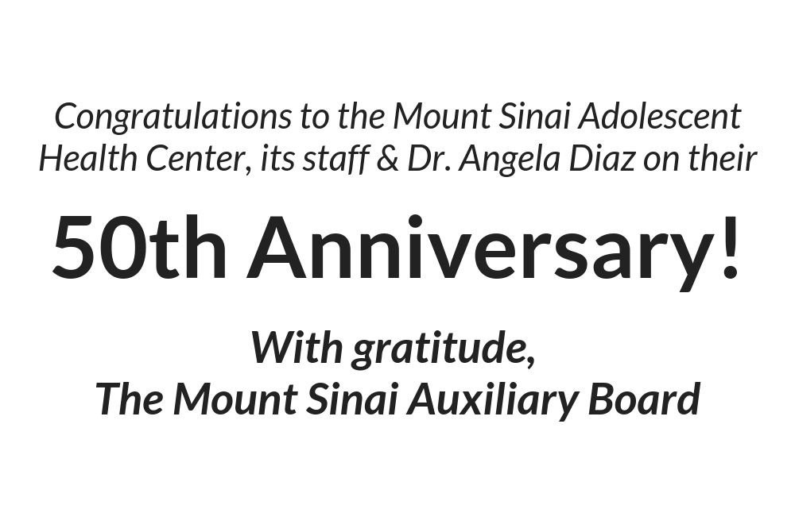

Slide 14
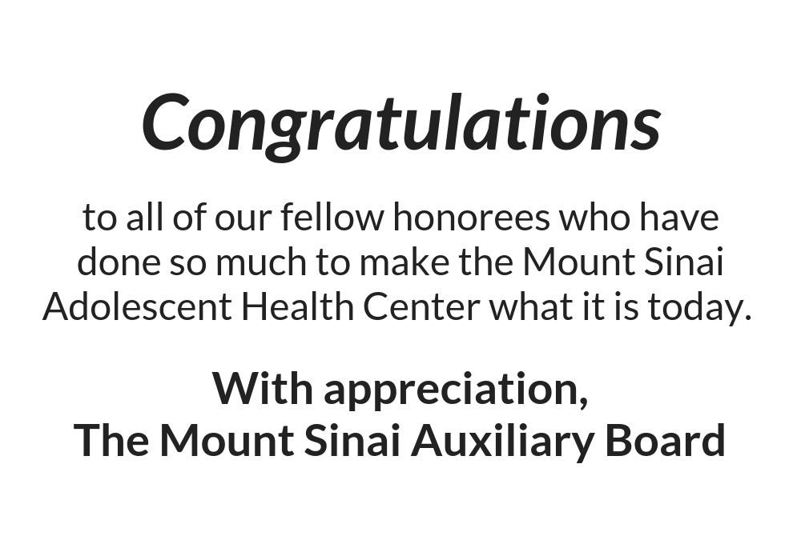

Slide 15
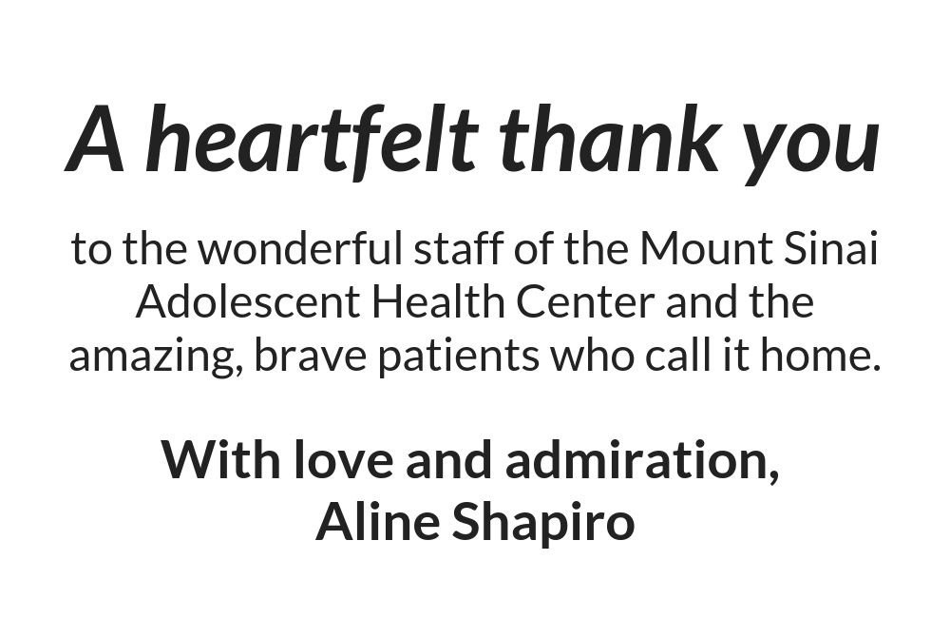

Slide 16
In honor of Peter F. May
Dad, we are so proud of you and all your hard-work
and dedication to Mount Sinai all these years.
We love you!
The May-Blauner Clan

Slide 17


Slide 18
Congratulations to Dr. Angela Diaz
and The Mount Sinai Adolescent Health Center on its 50th Anniversary
and the 2018 Legends honorees
Gary C. Butts, MD Lenore Katz-Cohen, OD Robert Cohen, OD Peter W. May
The Mount Sinai Auxiliary Board Bethany Novak, MS, RN, FNP-BC
Courtney Carrera-Ghatan & Saadi Ghatan, MD

Slide 19
The Department of Psychiatry congratulates
The Mount Sinai Adolescent Health Center
on its 50th Anniversary and the 2018 Legends honorees
Gary C. Butts, MD Lenore Katz-Cohen, OD Robert Cohen, OD Peter W. May
The Mount Sinai Auxiliary Board Bethany Novak, MS, RN, FNP-BC
Breakfast of Legends - October 30, 2018 René S. Kahn, MD, PhD
Esther and Joseph Klingenstein Professor & Chair, Department of Psychiatry and Behavioral Health System Icahn School of Medicine at Mount Sinai

Slide 20
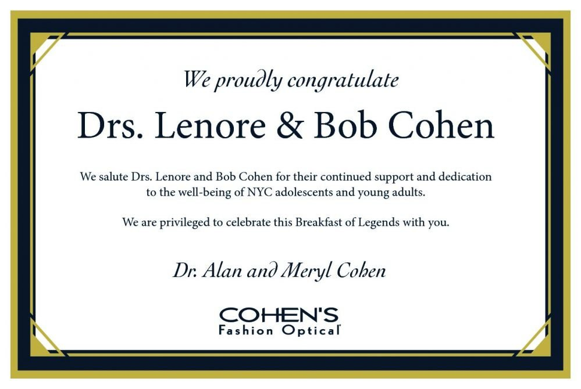

Slide 21
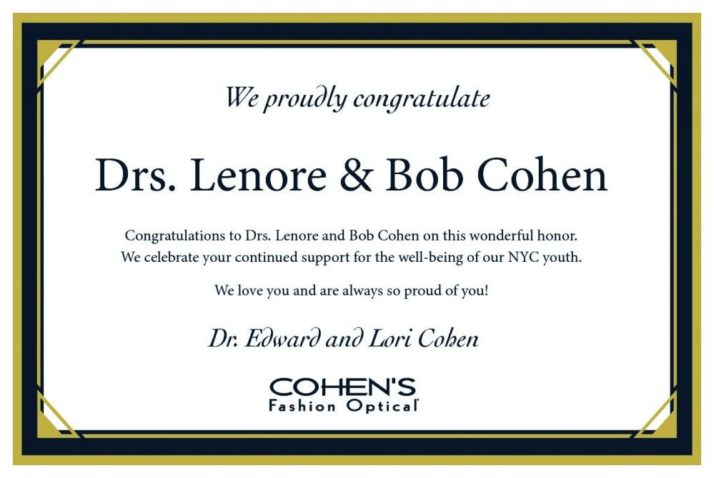

Slide 22
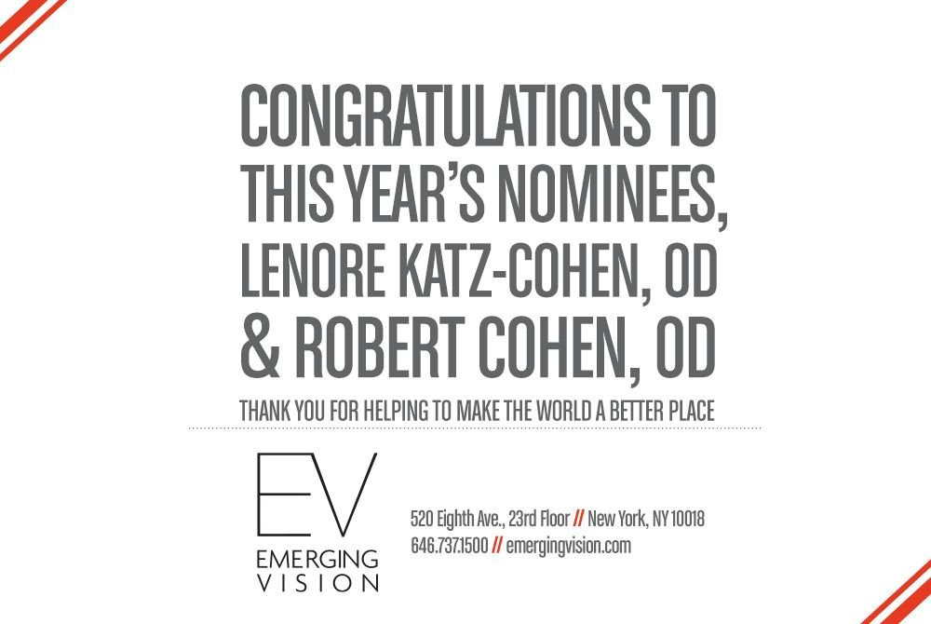

Slide 23
Martin Feinman and Amy Cooney
are thrilled to be supporting
the Mount Sinai Adolescent Health Center and the wonderful work they do
in providing services for youth

Slide 24
On behalf of Dr. Raja Flores
and the Department of Thoracic Surgery
we commend the work of Dr. Angela Diaz
and the Adolescent Health Center
Congratulations!
Raja M. Flores, MD

Slide 25
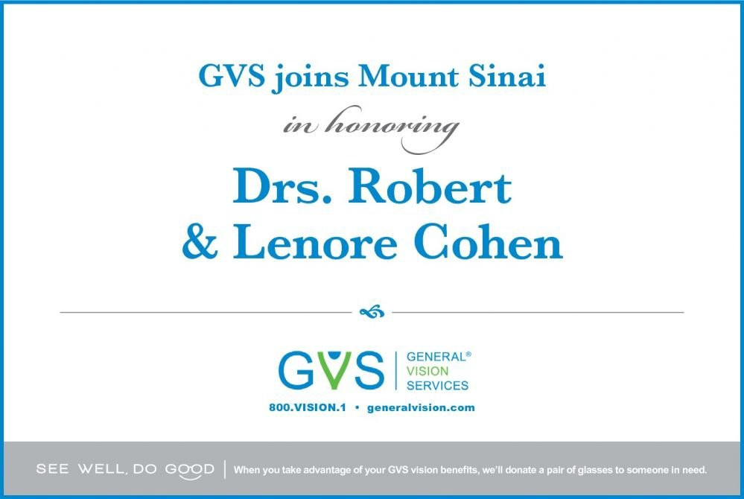

Slide 26
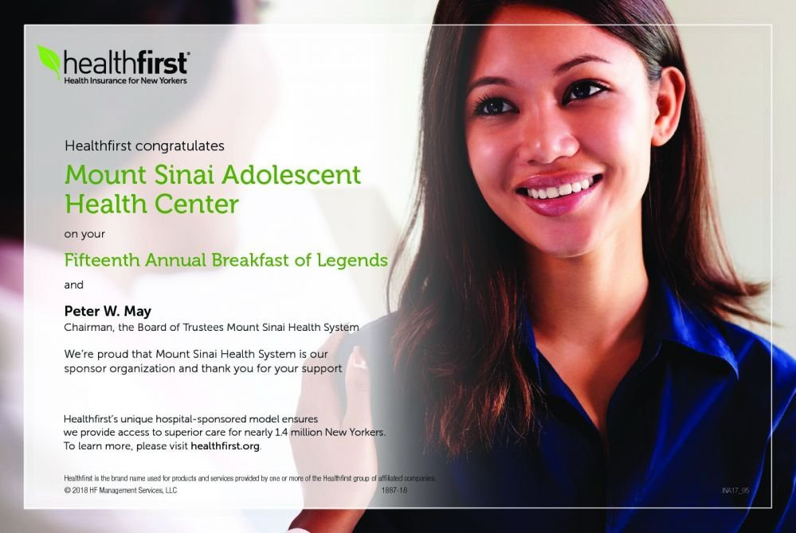

Slide 27
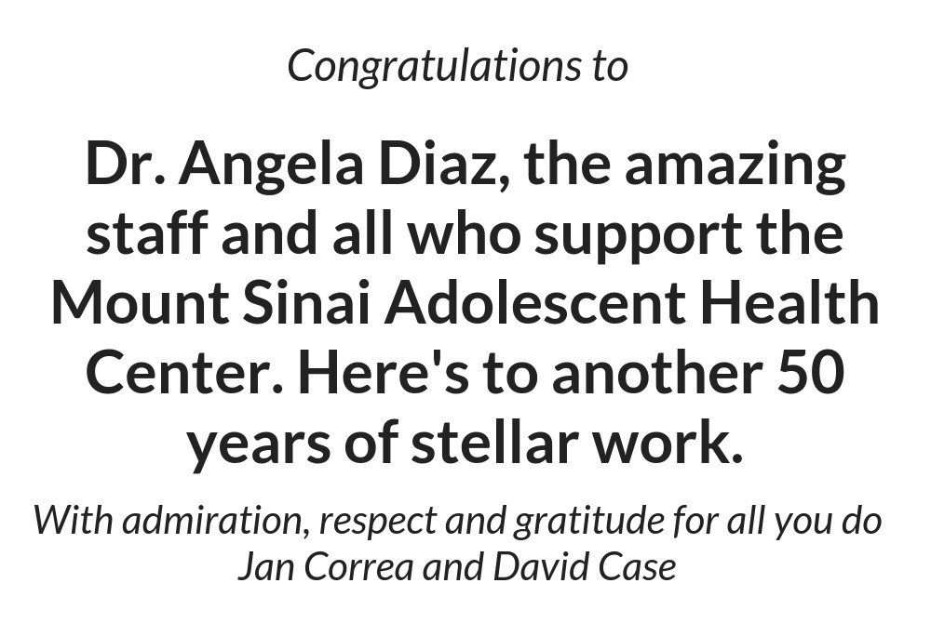

Slide 28
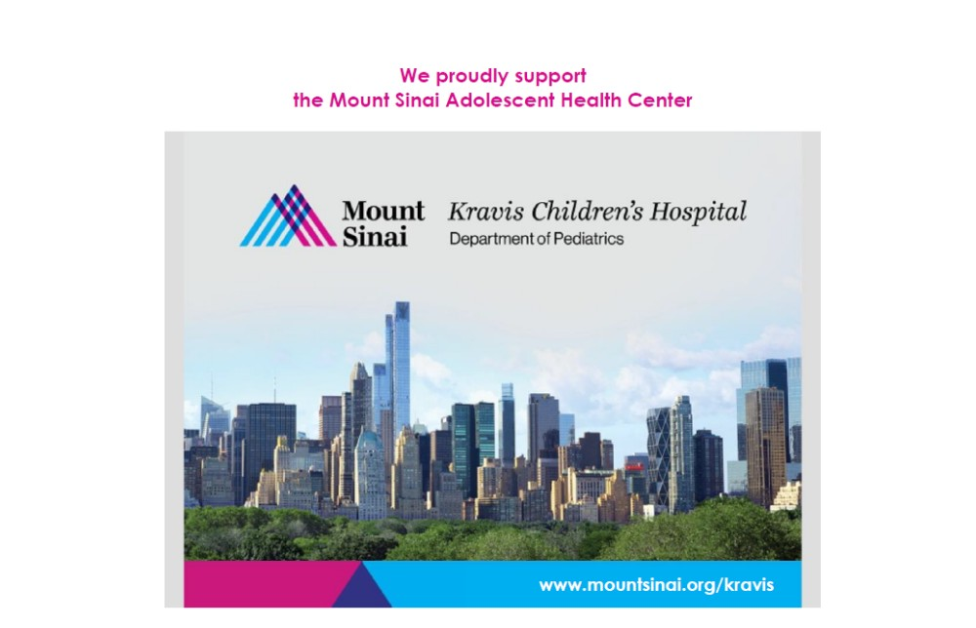

Slide 29
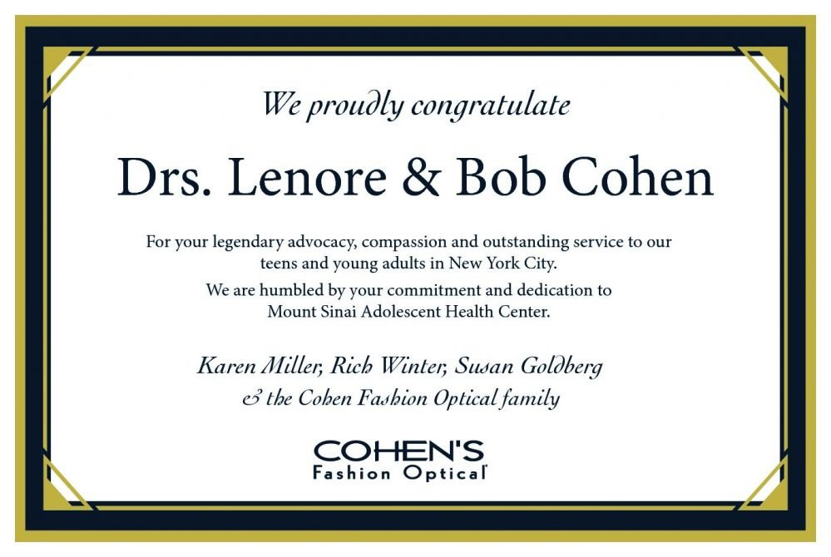

Slide 30
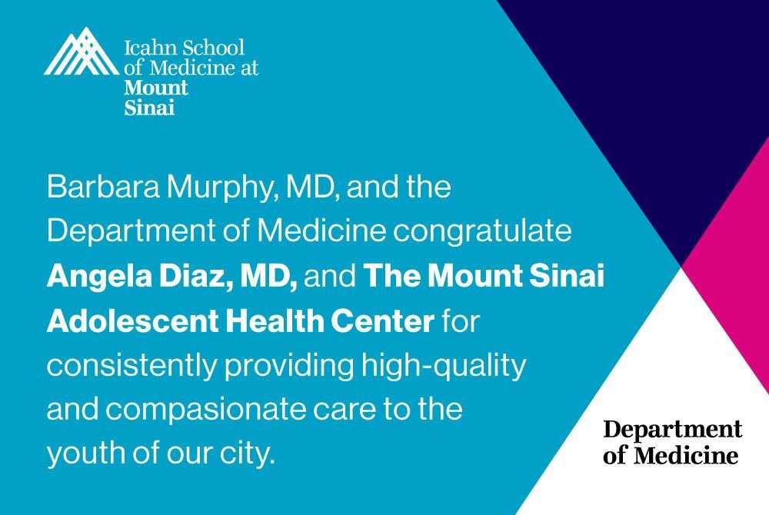

Slide 31
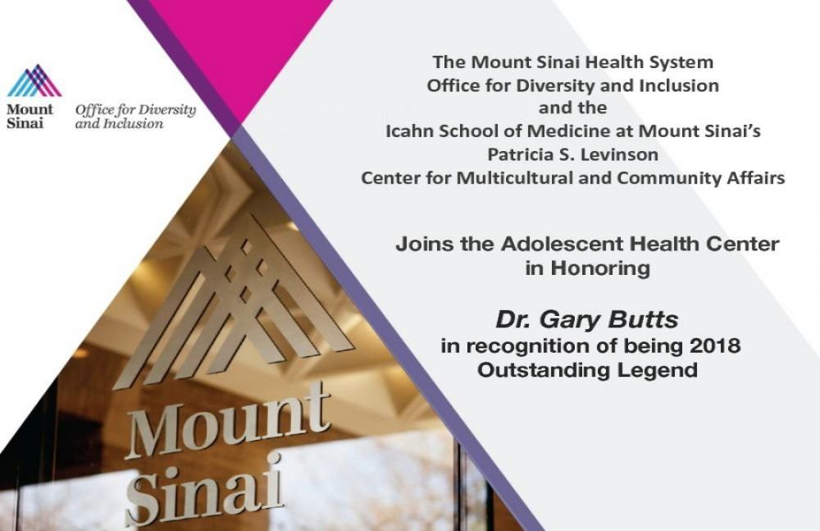

Slide 32
Congratulations Angela and Team!
Thank you for your wonderful work!
You are more important than ever!
Malva Rabinowitz

Slide 33
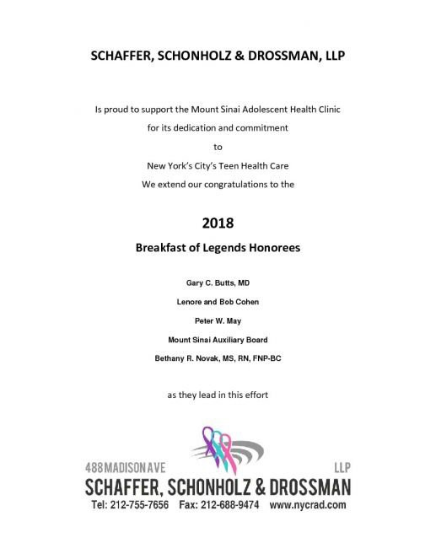

Slide 34

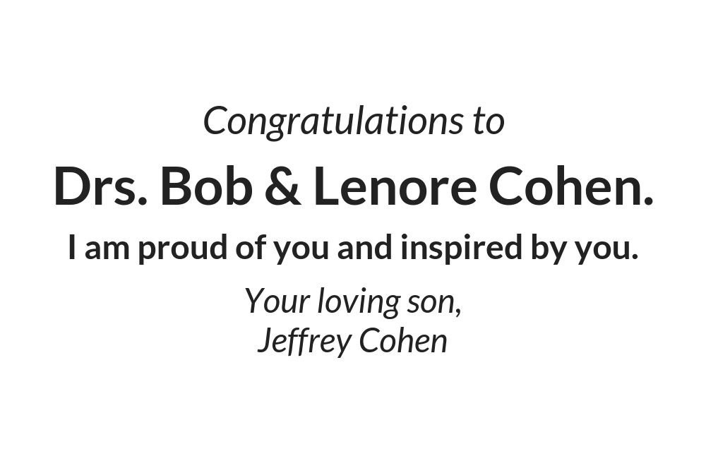

Slide 35
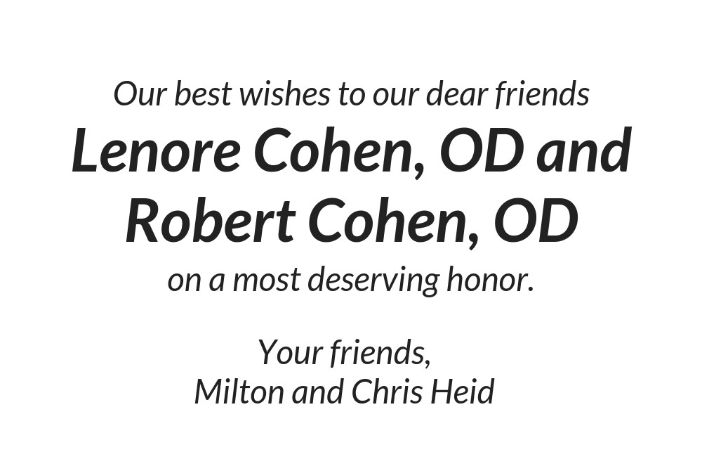

Slide 36
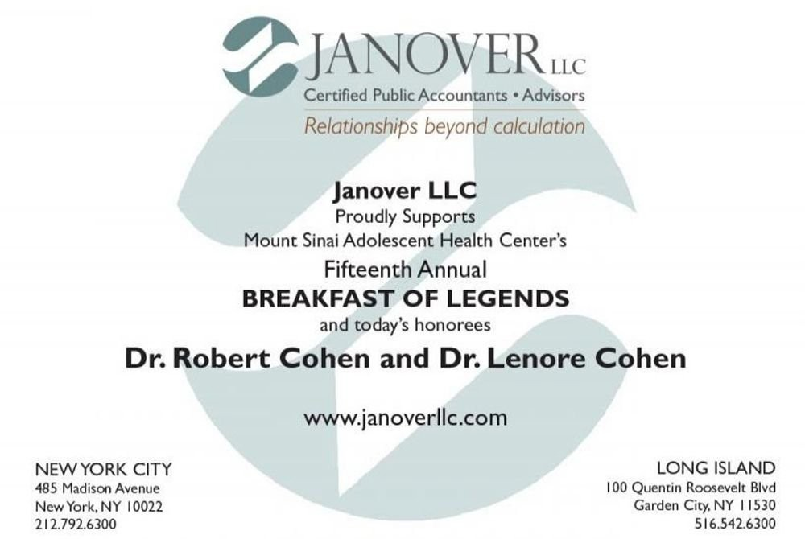

Slide 37
Congratulations on your incredible patient care
and service to teens.
Here's to your amazing future success.
Angela Diaz is a gem!
With love,
Harriet and David Kaufman, MD

Slide 38
Congratulations and thank you to Gary Butts, MD
We are grateful to you for directing the
Mount Sinai Health System
into a position of recognized leadership in diversity for health care systems.
I. Michael Leitman, MD, FACS

Slide 39
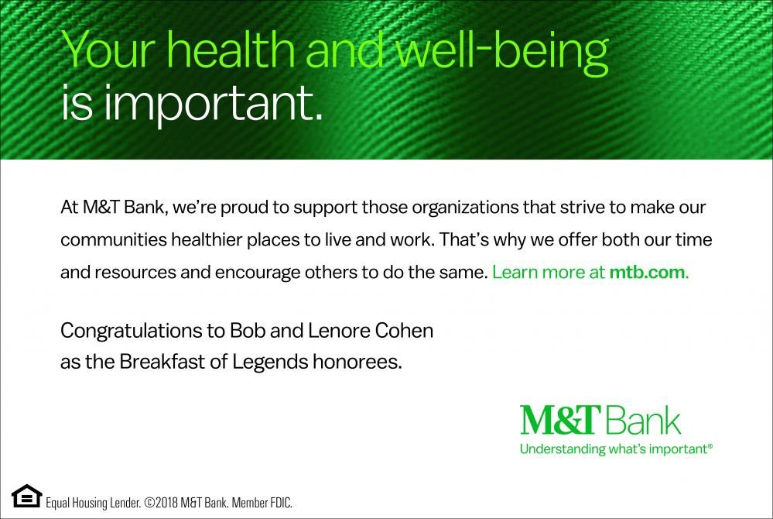

Slide 40
Congratulations to Dr. Diaz
and the entire staff of
the Adolescent Health Center.
Richard and Monica Macek

Slide 41
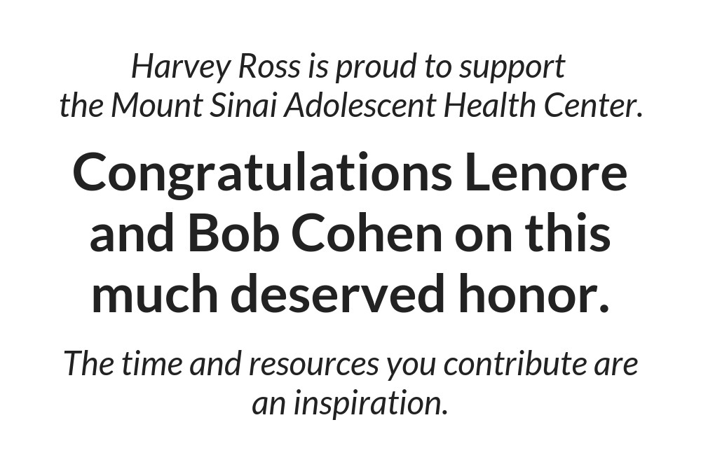

Slide 42
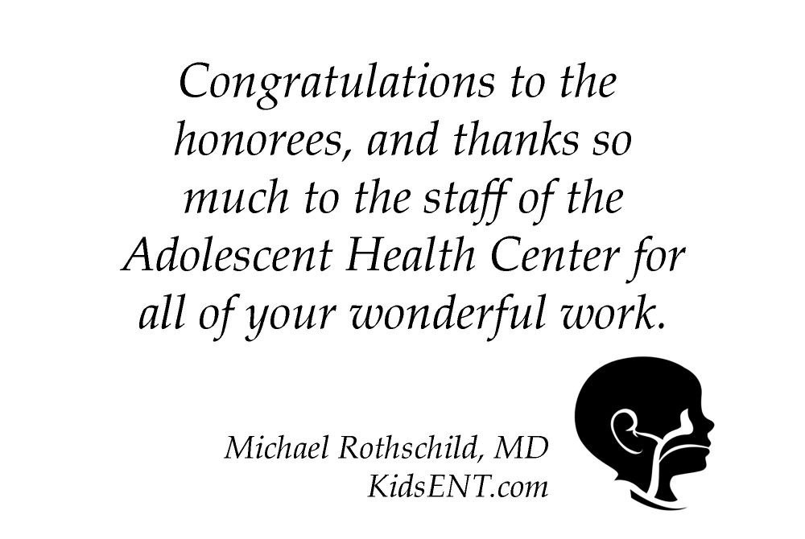

Slide 43
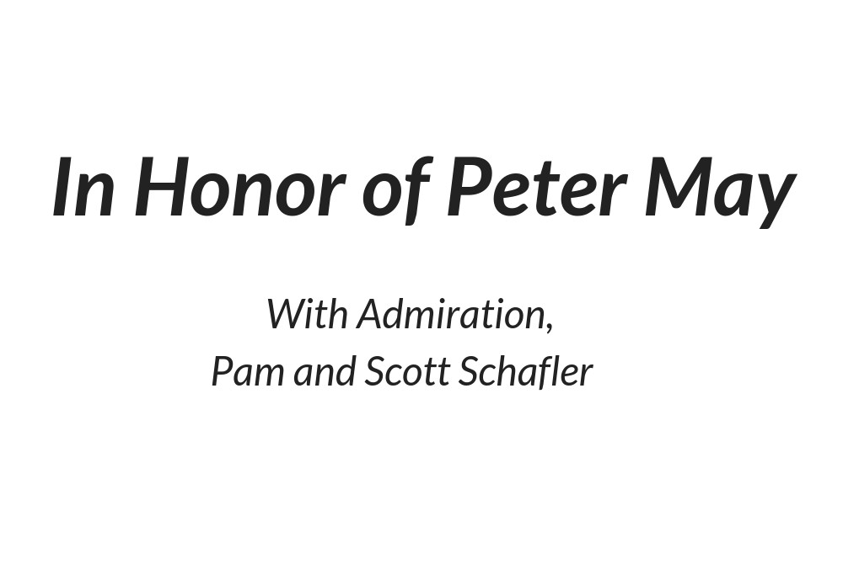

Slide 44
The Arnhold Institute for Global Health
honors and recognizes the pathbreaking work of
Dr Angela Diaz
and the
Mount Sinai Adolescent Health Center

Slide 45

Congratulations to
Drs. Bob and Lenore Cohen
With love and appreciation,
The families of
Jane Ann Poblete, Mylene Vizarra and Sonny and Mayeth De Villa

Slide 46
Congratulations to an incredible couple
Drs. Bob & Lenore Cohen
You make our world a better place
Palvi & Ripu Dhaman

Slide 47
In honor of
Dr. Angela Diaz,
a remarkable women, doctor, visionary, and a legend herself.
Terry Goldstein

Slide 48
We love and congratulate
Drs. Lenore and Bob Cohen
Your proud and adoring sister and cousin,
Amy Allen & Judy Steiner

Slide 49
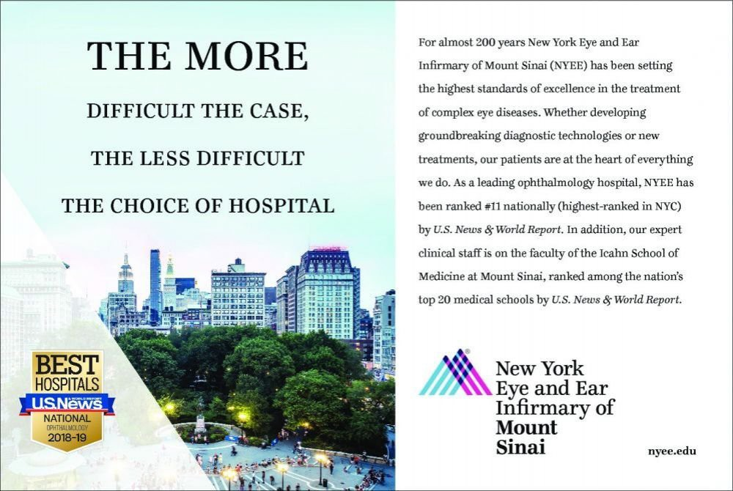

Slide 50



Slide 51
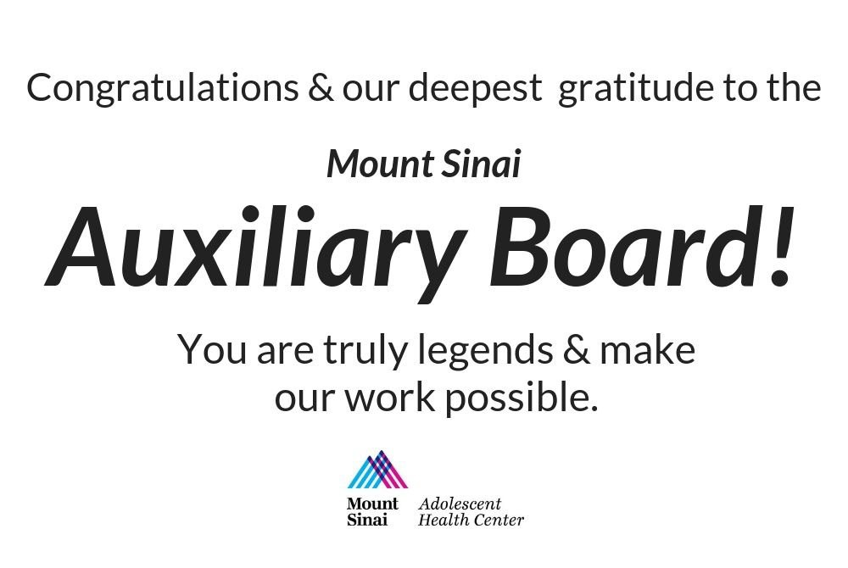

Slide 52


Slide 53


Slide 54


Slide 55


Slide 56


Slide 57

CONGRATULATIONS
To the
Mount Sinai Adolescent Health Center 15th Annual Breakfast of Legends
David R. Jones, President & CEO of the Community Service Society and the CSS Board of Trustees, salutes the Mount Sinai
Adolescent Health Center on its 15th Annual Breakfast of Legends.
Congratulations to all the Honorees

Slide 58
The Department of Dermatology salutes the Breakfast of Legends
in honor of Peter May.
Dr. Mark Lebwohl Department of Dermatology

Slide 59
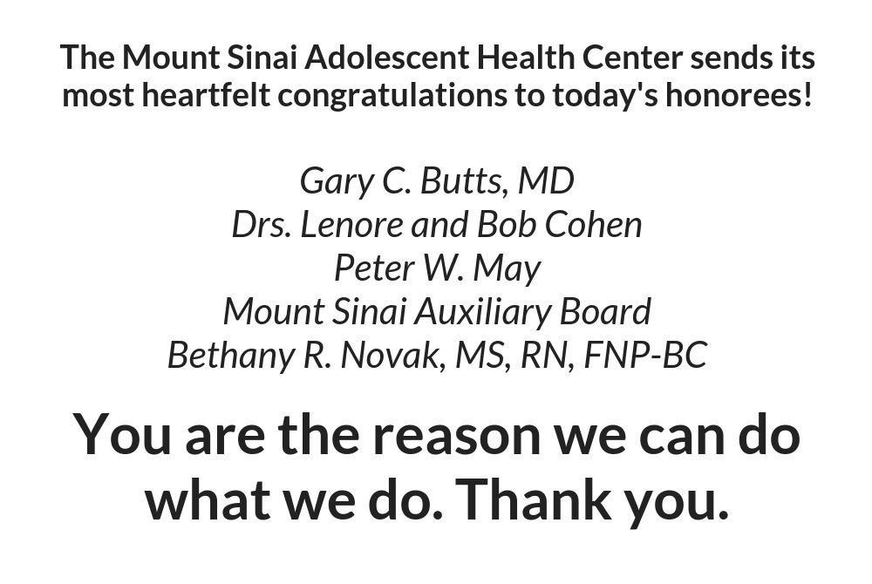

Slide 60


Slide 61
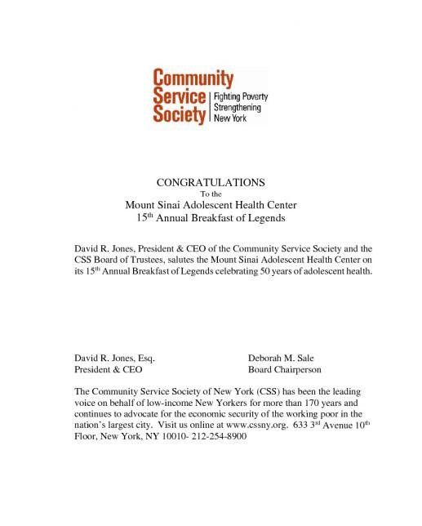

Slide 62


Slide 63
Thank you to our 2018 TCS New York City Marathon Team!
Run For Teens (MSAHC)
Abigail Allen, MD Lisa Anderson
Angela Diaz, MD, PhD Daniela Diaz, MD William Flynt
Charles Hunt Matthew Kane Byrne Lee Jimmy O'Keefe Meriellyn Rose Timothy Sasala
Sara Schwedelson Parrish Smith John Steever, MD Jendayi Waugh

Slide 64
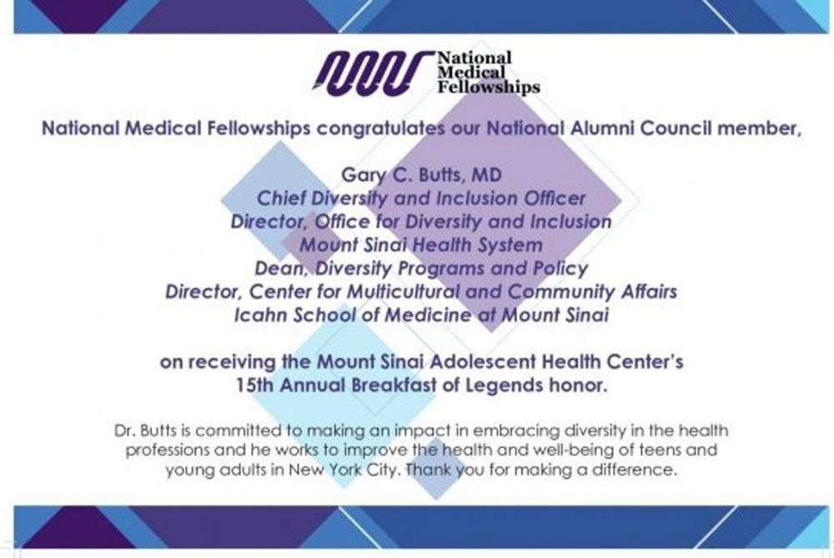

Slide 65
